Slide 1
How to Become a Member in TNNLU-NDLI Club
LOG ON TO
https://club.ndl.iitkgp.ac.in/sign-up

Slide 2

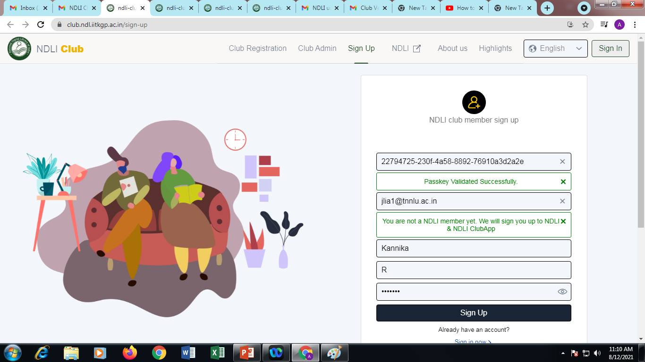
Our Institute Passkey is: 9283c3ff-891d-4f19-9af2-4c26d310a2b9
Step: 1
Copy Paste the Passkey + Enter.
Message will appear that (Passkey Validated Successfully).
followed that Enter your Email Id, further the Message will appear (You are not a NDLI member yet. We will sign you up to NDLI & NDLI ClubApp).
Enter Your First Name.
Enter Your Last Name.
Feed your Password.
Do Sig Up.

Slide 3
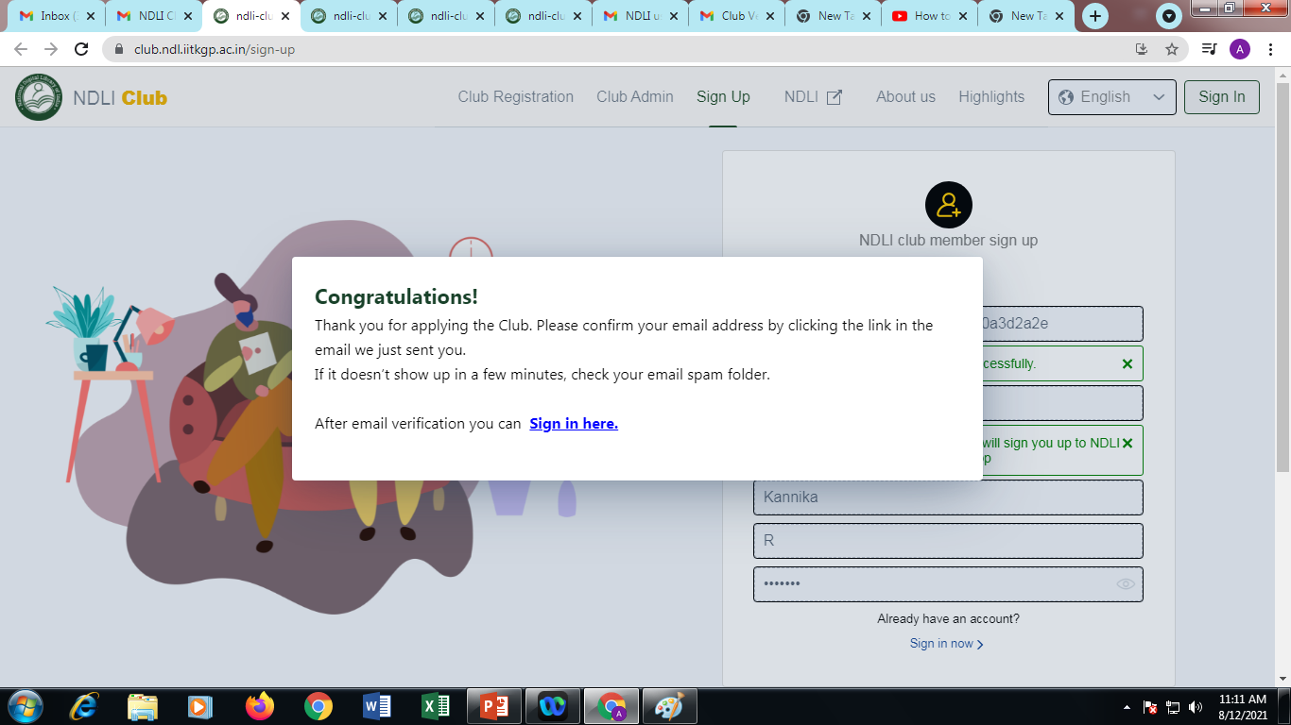
Step:2
Do sign in Your Registered E Mail and follow the instruction

Slide 4
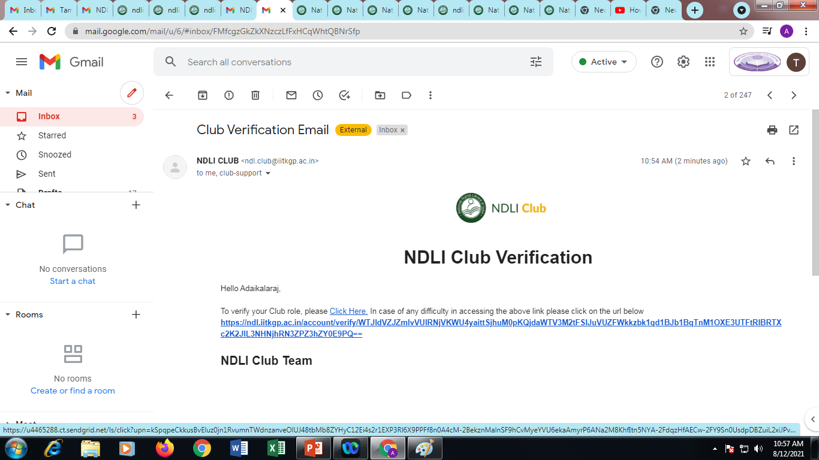
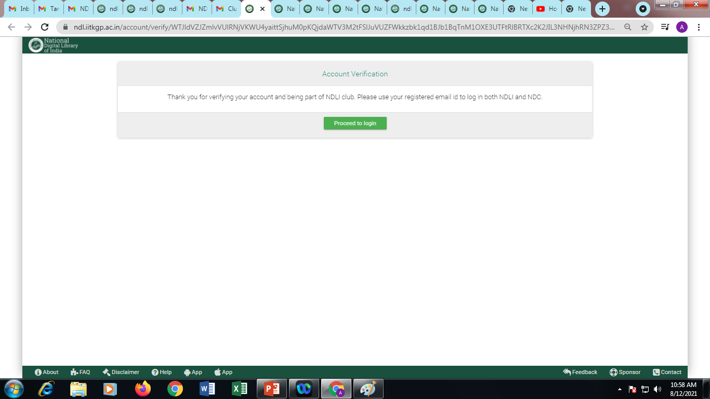
Step: 3
Check your inbox - Club Verification Email+ Click the (Click Here)
Step: 4
Message will appear that (Click Here Proceed to Log in).+ Click it.

Slide 5
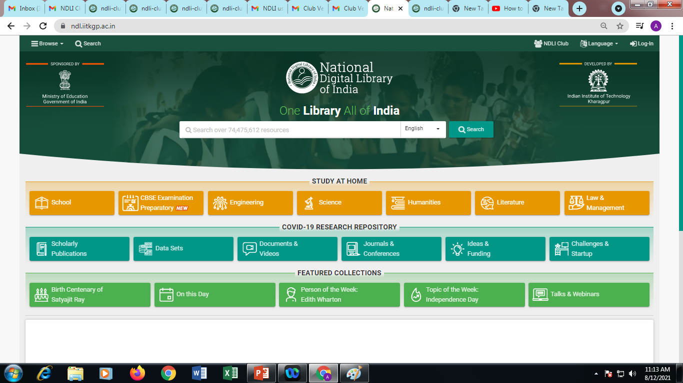
Step: 5
Click NDLI Club which is available on top of right side of the corner

Slide 6
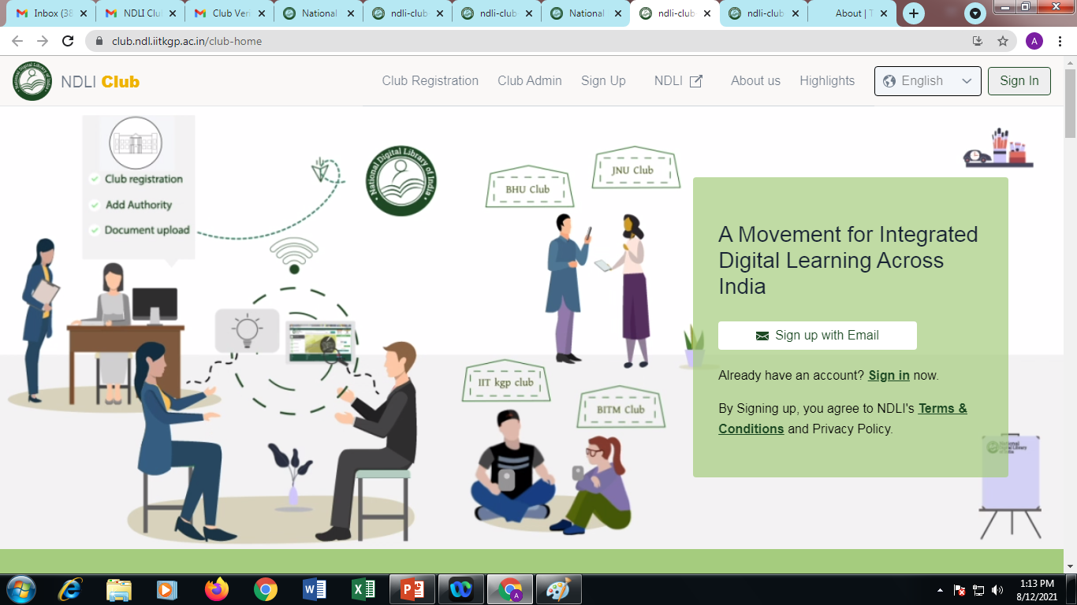
Step: 6
Click Sign in which is available on top of right side of the corner

Slide 7
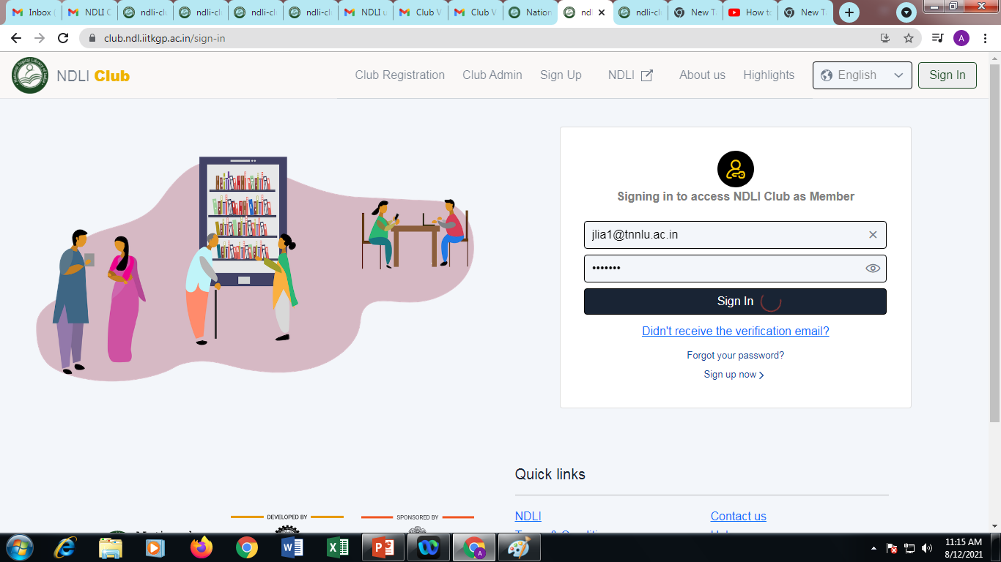
Step: 7
Enter Your registered Email & give Password (NDLI Password)
Do Sig in

Slide 8
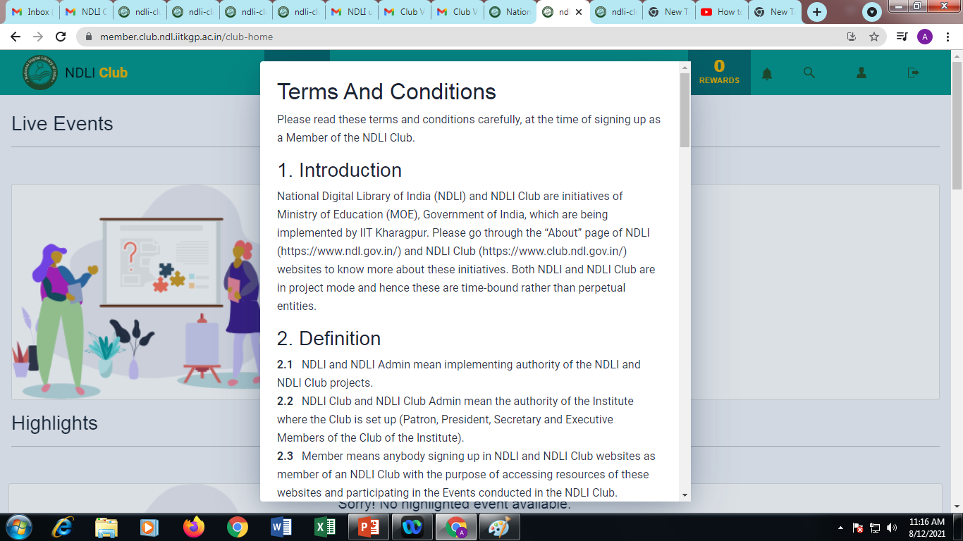
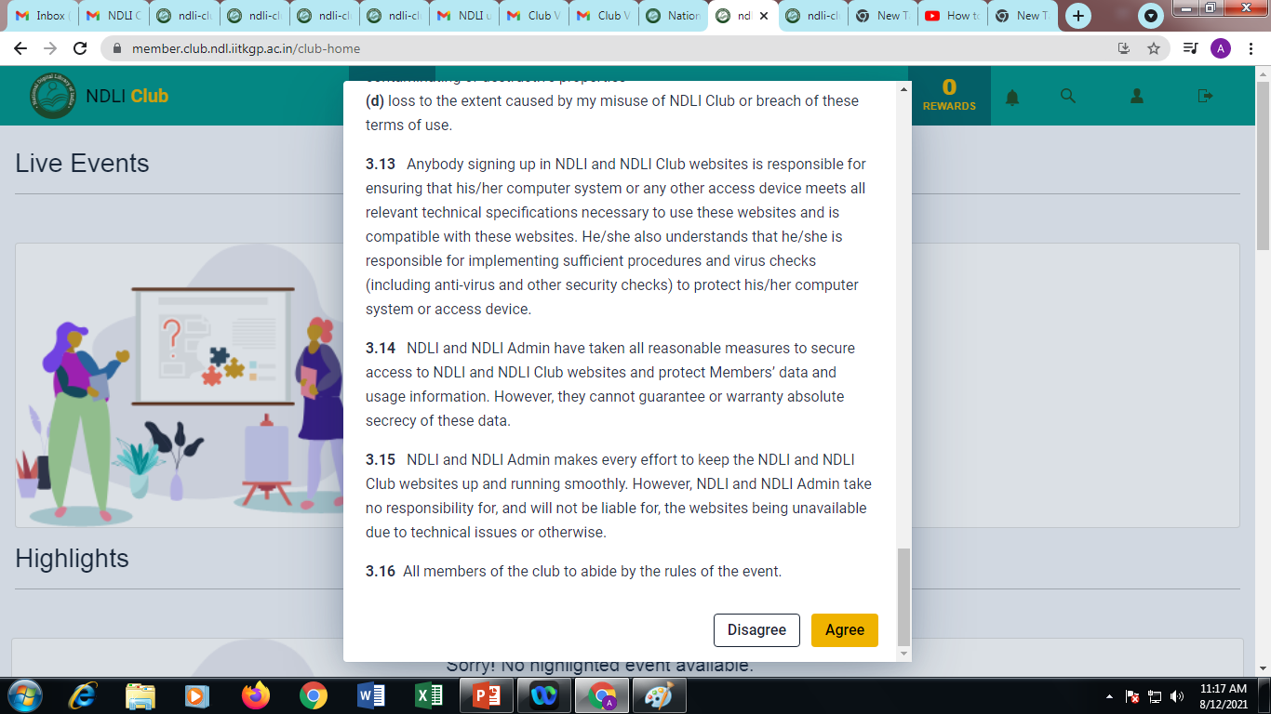
Step: 8
Once sign in the Terms and
Condition screen will appear,
Read the Terms and
Condition carefully and
Agree it.

Slide 9
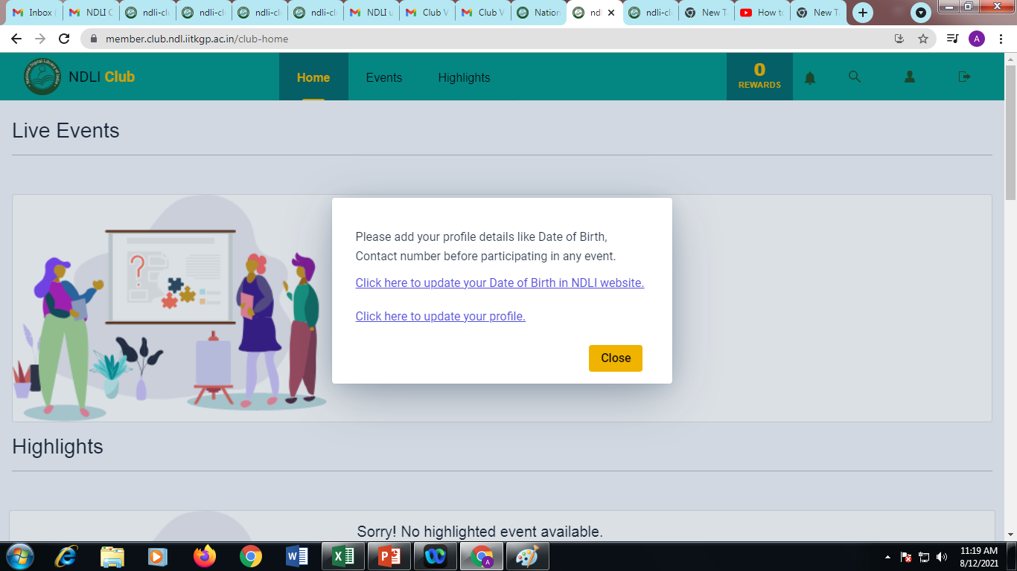
Step: 9
Once Agreed the below message will appear (Click here to update Your Profile)
Do click it

Slide 10
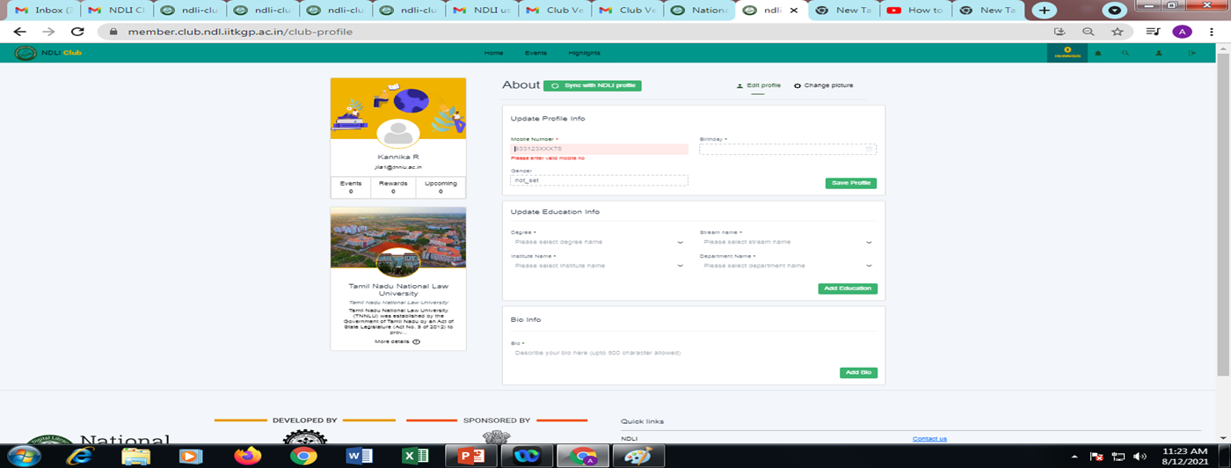


Step: 10
Now Your Name , e- mail id and our university photo will appear on the screen (left side) followed by your personal details to be updated on right side. And Click Aero key on the right side corner

Slide 11
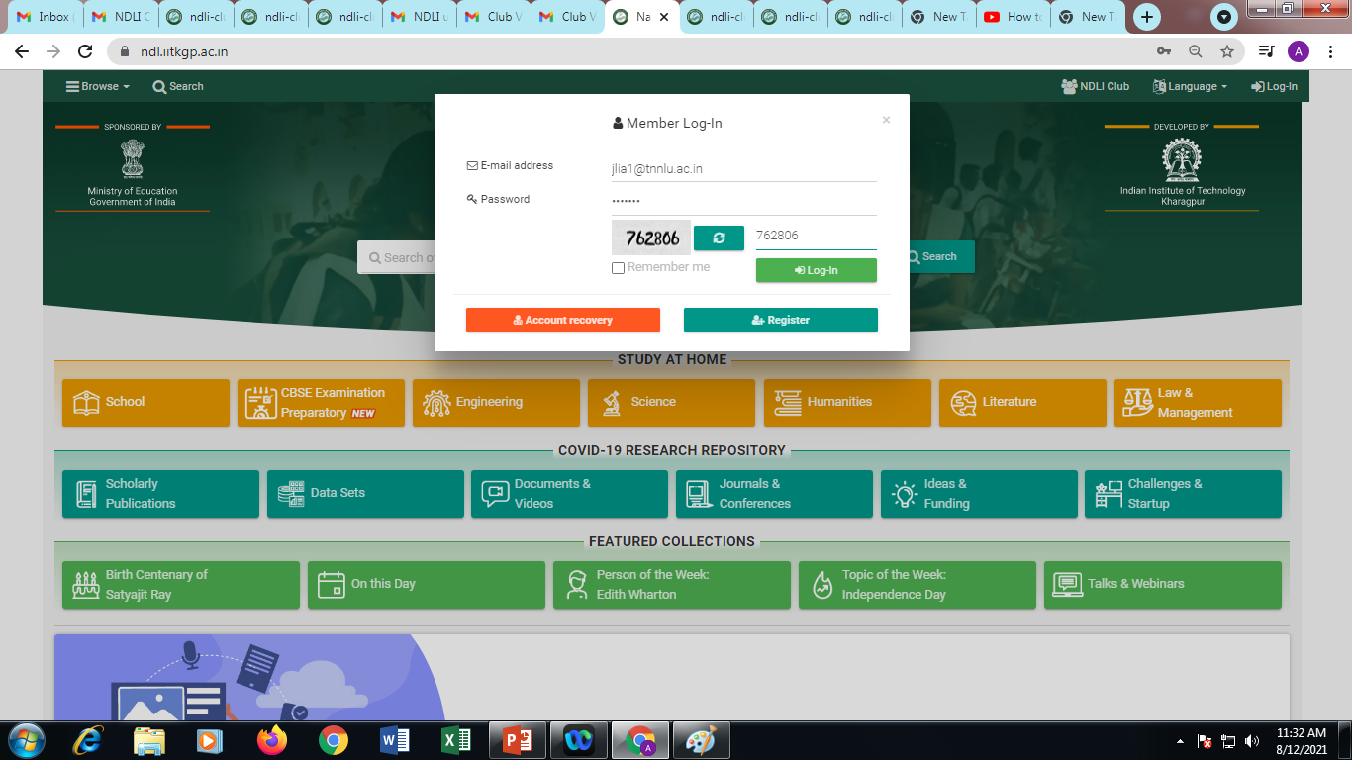
Step: 11
Once Updated Login screen will appear for recheck the status
Enter the registered Email Id & Password.
And type the code
Do Log in.

Slide 12
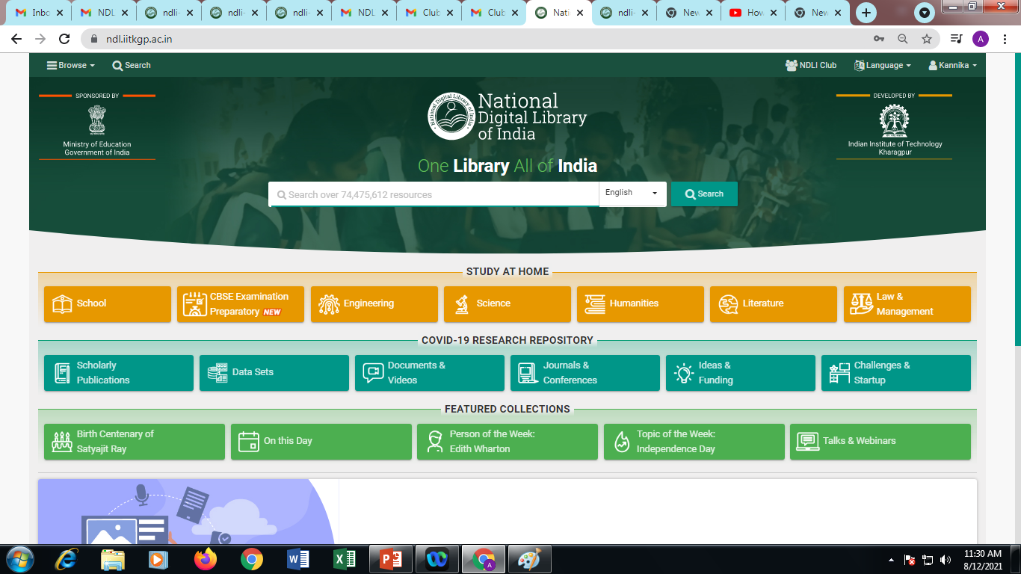
Step: 12
THE NDLI’S Main Page will appear and you can find your name on top of the right side corner which means
You have successful registered and now you can make use of it.

Slide 13
Query and doubts please let us know
library@tnnlu.ac.in
(or)
asstlibrarian@tnnlu.ac.in

Slide 14


